Slide 1

Machine learning algorithms for the classification of object surface structure using reflected ultrasonic signals
Master’s Thesis Topic
Full Name: Sahana Prasad
Matriculation Number: 1324329
First Supervisor: Prof. Dr. Andreas Pech
Second Supervisor: Prof. Dr. Peter Nauth
Date: 28.06.2022

Slide 2
Agenda
Introduction
Methodology
Results
Conclusion
Discussion and Future Work
Q&A Session

Slide 3
Introduction Main aim of this project?
An accurate object classification system to assist autonomous driving systems.
Avoiding potentially hazardous events by allowing early detection and avoidance of potential hazards.
To enhance classification predictions by using sensor data.

Slide 4
Introduction Objective
How ADC & FFT data from an ultrasonic sensor may be utilized for object categorization.
A comparison of the CNN-based design and the MLP-inspired architecture, as well as their performance.
An investigation of ultrasonic data that influences the functioning of networks for different object structures.

Slide 5
Methodology Equipement Description
Tools and Technologies | Version | Usage
Anaconda Navigator | 2.1.4 | Navigator for VS code and Spyder
MATLAB | 5.3.1 | Generating waveforms
Optical Bench appartus |  | Tool to setup the experiments
Python | 3.8.0 | Backend and Frontend development Feature Extraction
Redpitaya Kit | STEMlab 125-14 | Data collecting platform
SciDAVis | 0.2.0 | Generating plots
Spyder | 5.1.5 | Development of ML algorithms
Ultrasonic sensor | SRF02 | Collect different measurements from objects
UDP Client | 1.1 | FFT & ADC raw data collection
Visual Studio Code | 1.67.2 | Development of GUI

Slide 6
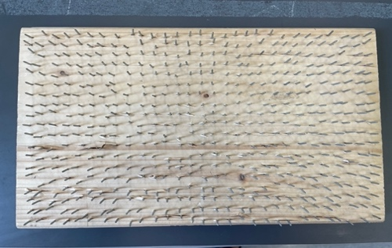
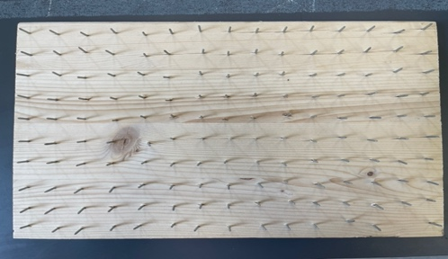
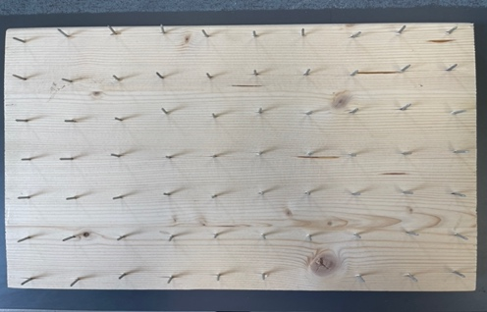
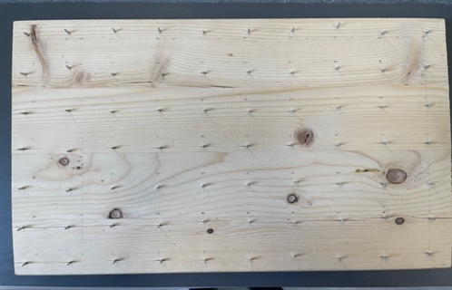
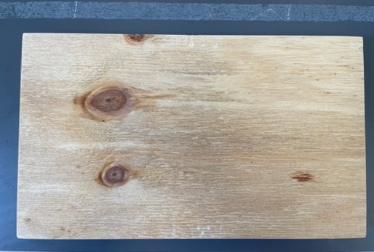
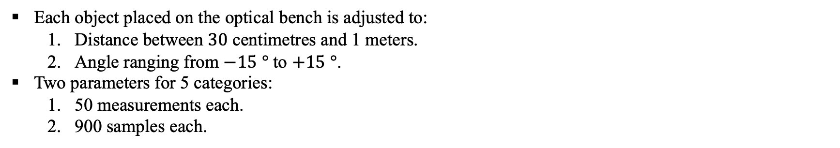
Methodology Data Collection
Each object placed on the optical bench is adjusted to:
Distance between $30$ centimetres and 1 meters.
Angle ranging from $−15$ $°$ to $+15$ $°$.
Two parameters for 5 categories:
50 measurements each.
900 samples each.
Nailbed1 Nailbed2 Nailbed3 Nailbed4 Nailbed5

Slide 7
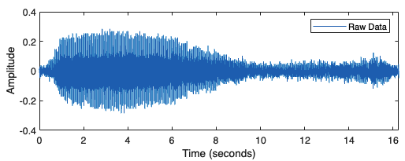
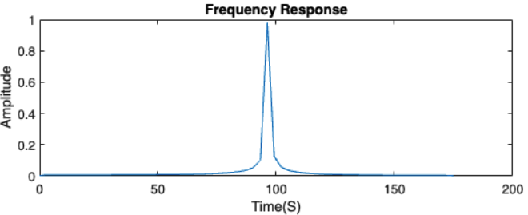
Methodology Data Pre-Processing
Quality of each signal is improved due to the potential for unwelcome interference from the outside.
The unfiltered raw signal is transformed into a filtered one by means of the Hamming window.

Slide 8
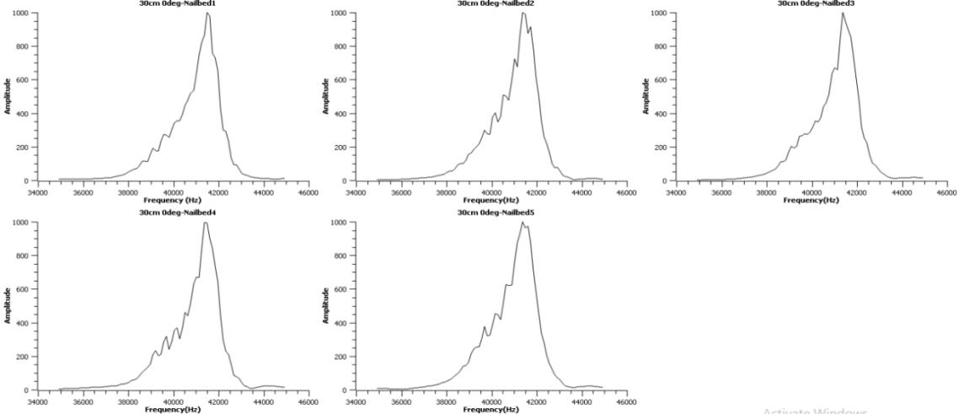

Methodology Data Pre-Processing
Angle measurement plots for a distance 30 cm at angle 0$°$

Slide 9
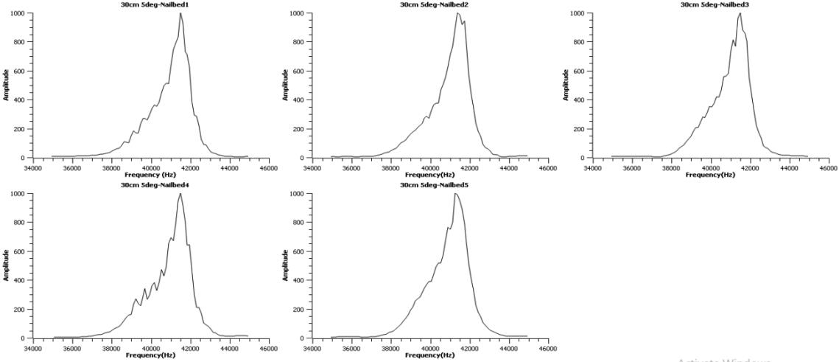

Methodology Data Pre-Processing
Angle measurement plots for a distance 30 cm at angle 5$°$

Slide 10
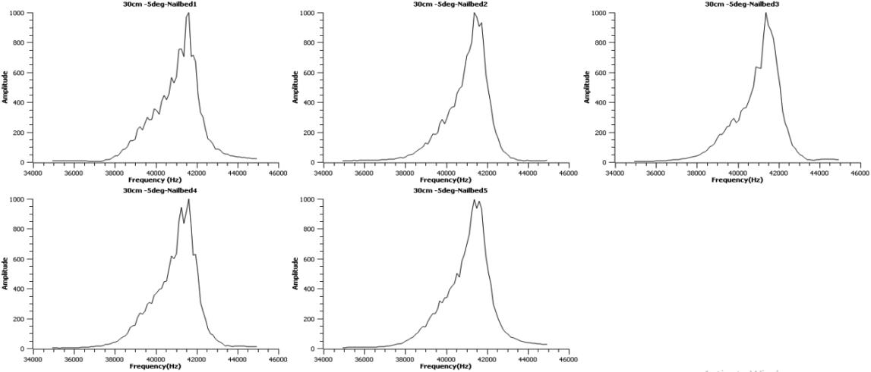

Methodology Data Pre-Processing
Angle measurement plots for a distance 30 cm at angle -5$°$

Slide 11
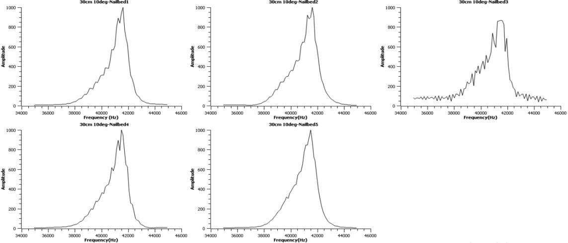

Methodology Data Pre-Processing
Angle measurement plots for a distance 30 cm at angle 10$°$

Slide 12
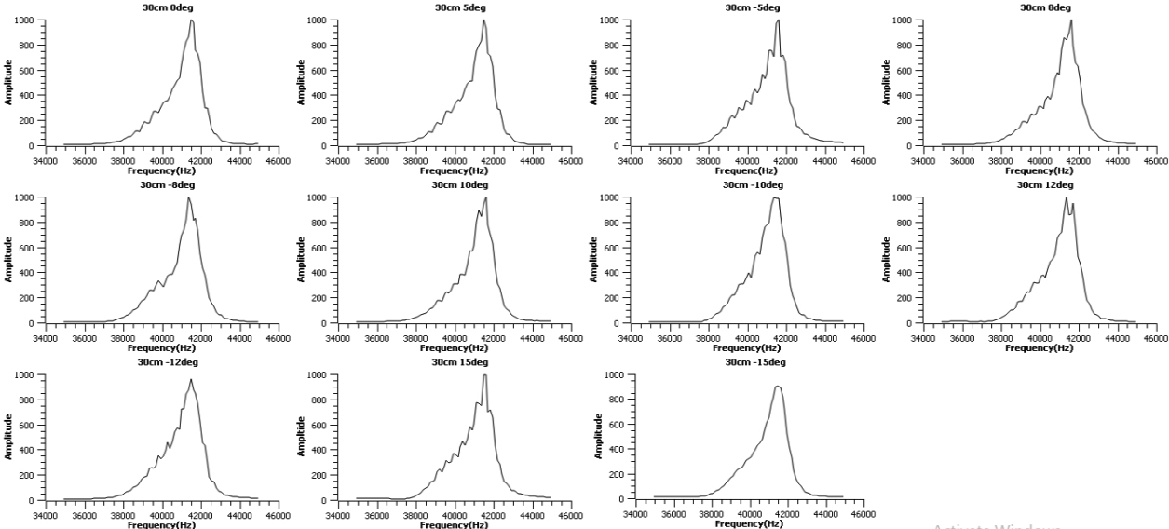
Methodology Data Pre-Processing
Distance measurement plots for Nailbed 1

Slide 13
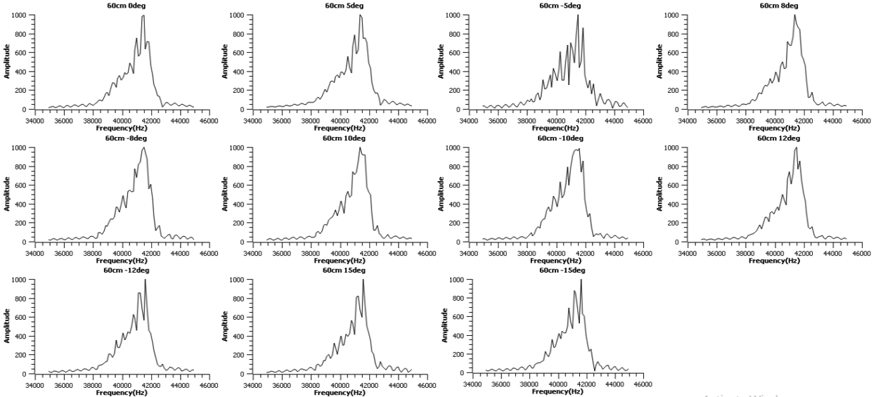
Methodology Data Pre-Processing
Distance measurement plots for Nailbed 4

Slide 14
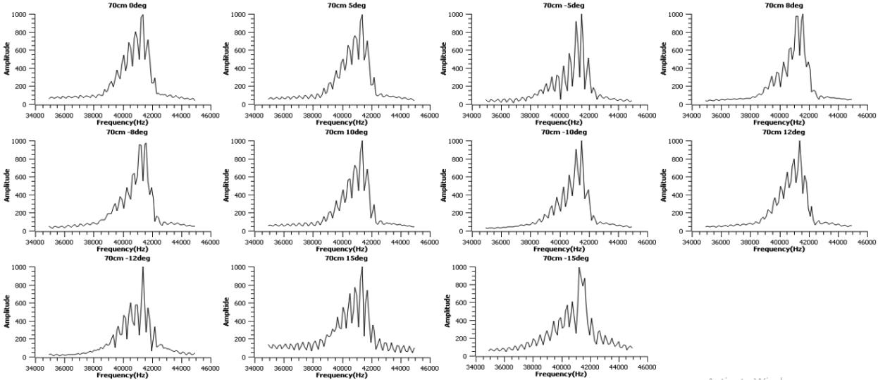
Methodology Data Pre-Processing
Distance measurement plots for Nailbed 5

Slide 15
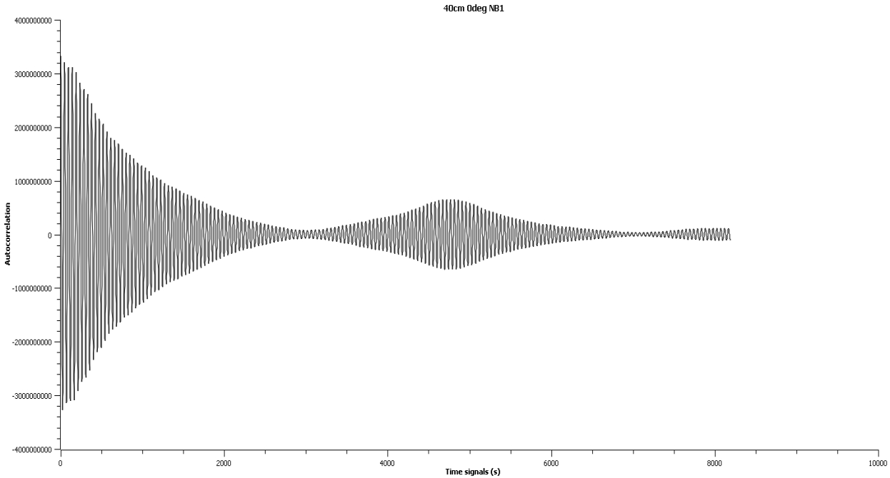
Methodology Data Pre-Processing
Autocorrelation: Perform Autocorrelation followed by FFT, on time signals having 16384 datapoints.
Sampling interval of 1.95 MHz

Slide 16
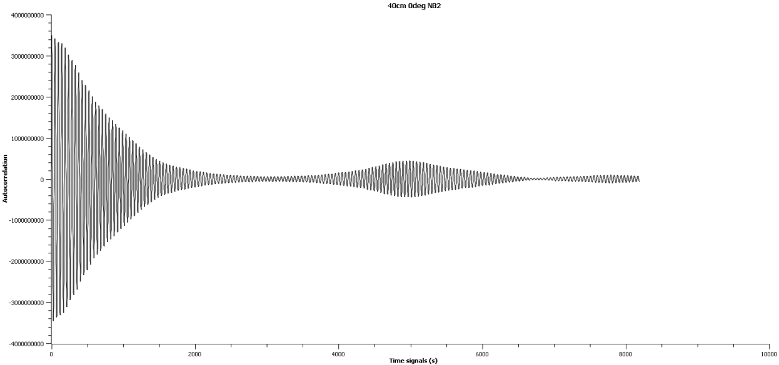
Methodology Data Pre-Processing
Autocorrelation on time signals having 16384 datapoints with sampling interval of 1.95 MHz

Slide 17
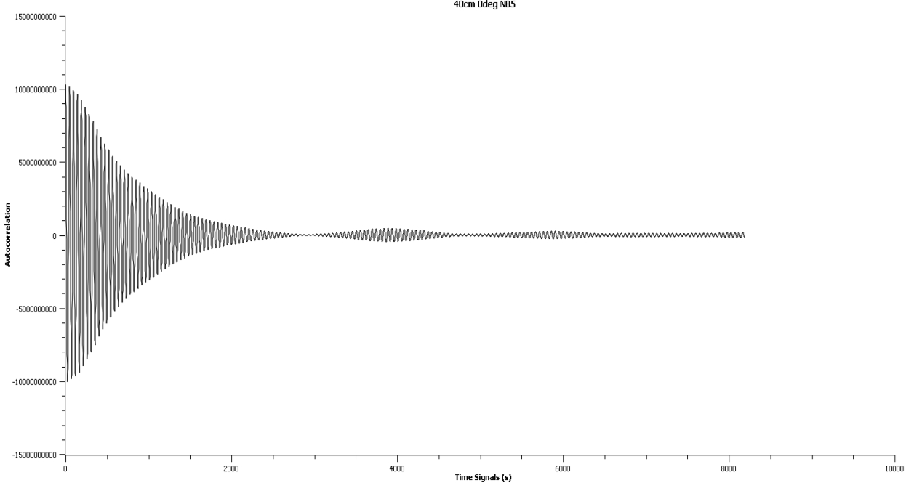
Methodology Data Pre-Processing
Autocorrelation on time signals having 16384 datapoints with sampling interval of 1.95 MHz

Slide 18
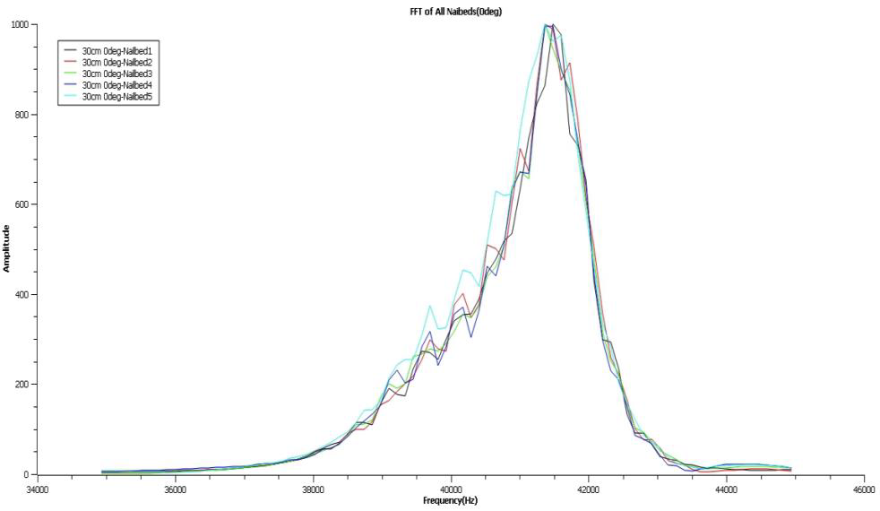

Methodology Feature Extraction
Consolidated mean FFT graph for Nailbed 1, 2, 3, 4 and 5 at 30 cm $0°$

Slide 19
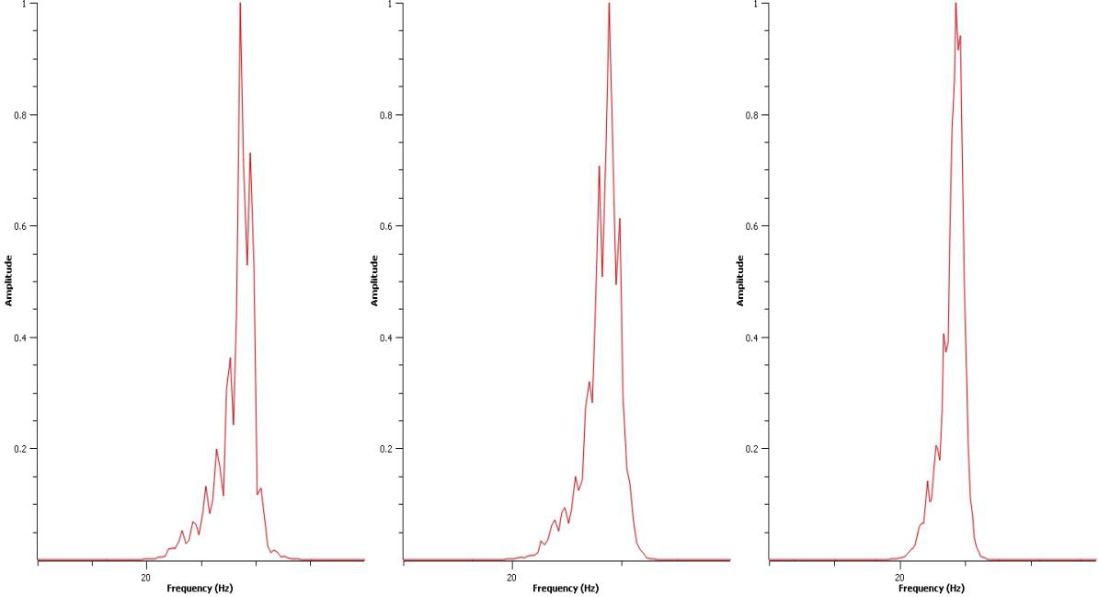

Methodology Feature Extraction
Consolidated graph of FFT on Nailbed 1, Nailbed 2 and Nailbed 5 respectively, after performing Autocorrelation function at 40 cm $0°$

Slide 20
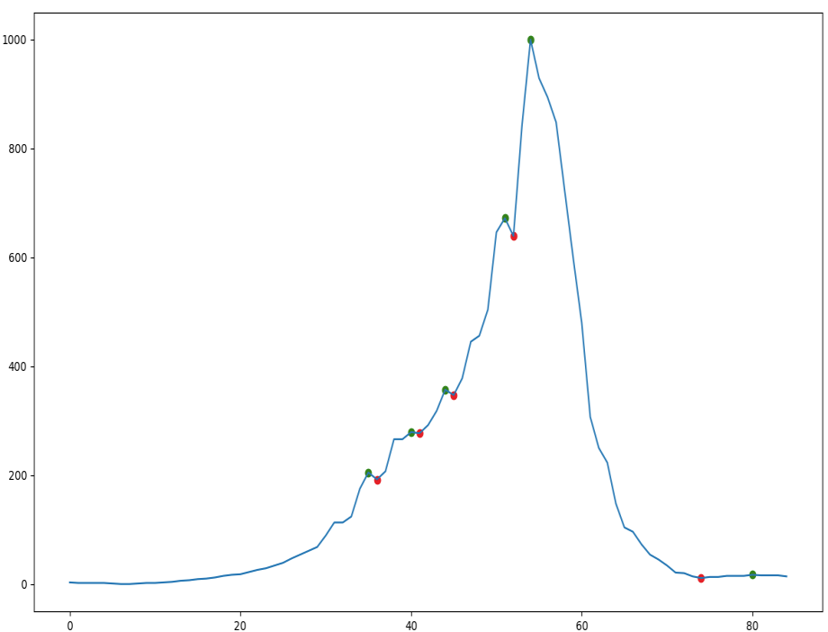
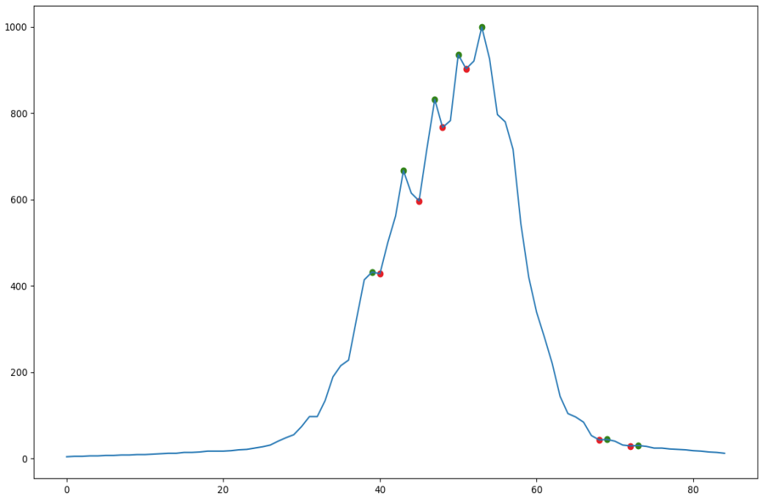



Methodology Feature Extraction
Mean: 𝐴𝑣𝑒𝑟𝑎𝑔𝑒 (𝜑) = $\frac{\text{Sum} \text{of} \text{t}\text{h}\text{e} \text{data} \text{values}}{\text{Total} \text{number} \text{of} \text{data} \text{values} }$
Peak FTT:
Nailbed 3 30 cm 0$°$
Nailbed 5 40 cm 10$°$

Slide 21
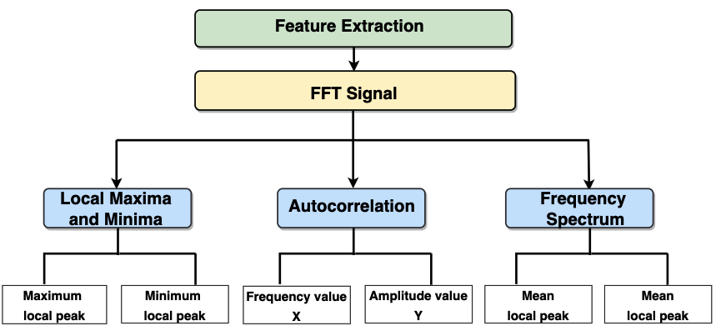
Methodology Feature Extraction
The reflected signal fluctuates considerably if the wooden board contains nailbeds of varying sizes.
Key property that can be utilized to differentiate items from one another.

Slide 22
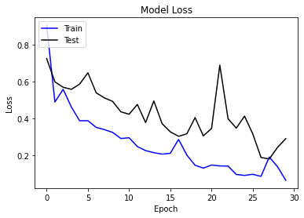
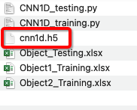
Results Experiment 1.1
Differentiate between Nailbed 5 and the other Nailbeds by observing how they react to different stimuli.
CNN results:
Training

Slide 23
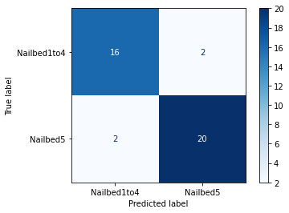
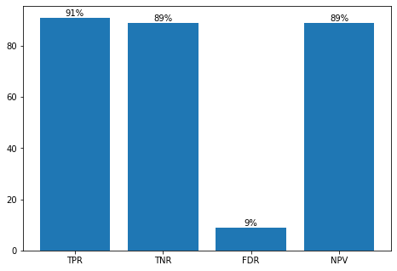
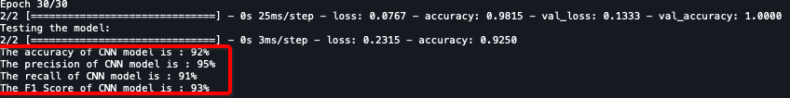
Results Experiment 1.1
CNN results:
Testing
TP
FP
FN
TN

Slide 24
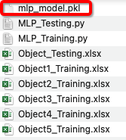
Results Experiment 1.1
Differentiate between Nailbed 5 and the other Nailbeds by observing how they react to different stimuli.
MLP results:
Training

Slide 25
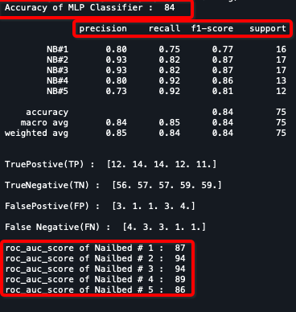
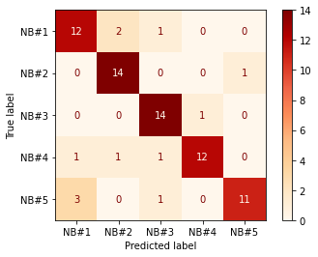
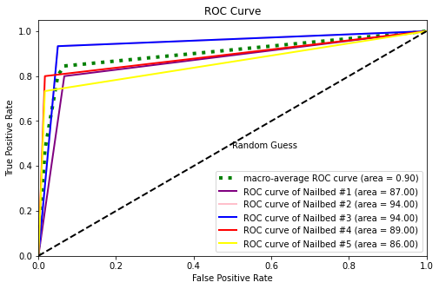
Results Experiment 1.1
MLP results:
Testing

Slide 26
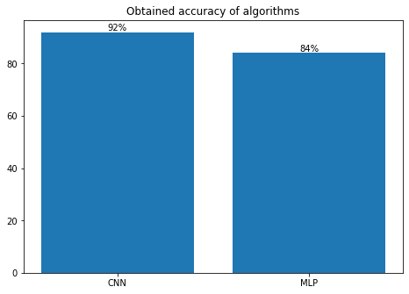
Results Best fit model?

Slide 27
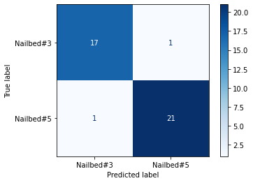
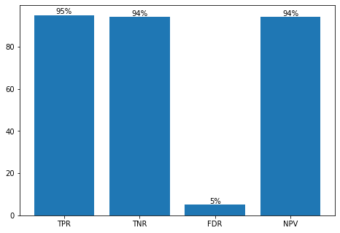
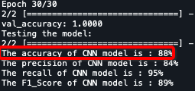
Results Experiment 1.2
The angle that produces the best results for a distance of 30 centimetres in Nailbeds 3 and 5
CNN results:
Testing
TP
FP
FN
TN

Slide 28
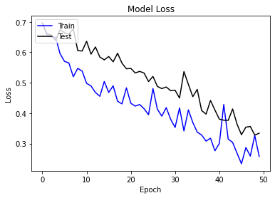
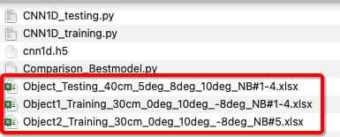
Results Experiment 1.3
Primary objective is to determine if we are able to achieve the accuracy anticipated using different distance and angle datasets
CNN results:
Training

Slide 29
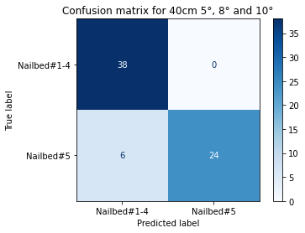
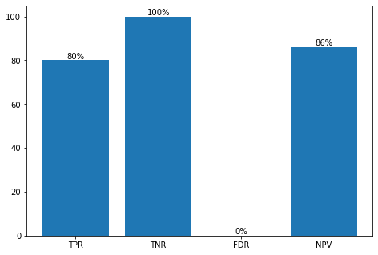
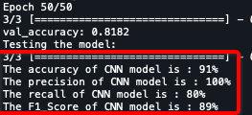
Results Experiment 1.3
CNN results:
Testing
TP
FP
FN
TN

Slide 30
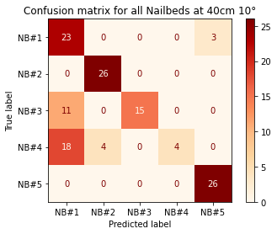
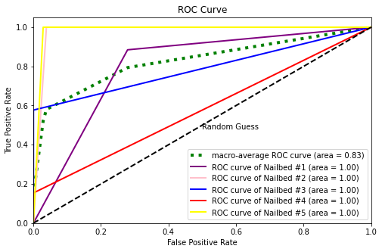

Results Experiment 1.4
The autocorrelation function is used to determine correlation between points that are separated by a variety of time lags
To determine whether the dependency is linear in order to generate smooth curves for our experiment.
MLP results:
Testing

Slide 31

Results GUI Demo

Slide 32
Conclusion
Machine learning algorithms can successfully undertake object categorization when given only raw data from ultrasonic sensors.
CNN has a strong performance, whereas MLP has a weak performance where CNN-1D over MaxPooling and other measures do not yield superior MLP results .
If there are significant discrepancies between the training data and the testing data, accuracy instantly degrades.

Slide 33
Discussion and Future Work
A unique target categorization technique based on range of FFT characteristics and machine learning algorithms.
Furthermore, such strategies have the drawback of only being applicable to static targets.
The sensors are inexpensive, they are insufficient to meet the demanding needs of fully autonomous cars.
When compared to ultrasound sensors, vision-based sensors such as cameras provide more comprehensive information, but they are not as resistant to severe weather and low light situations.

Slide 34

THANK YOU

Slide 35

Q & A

